Slide 1
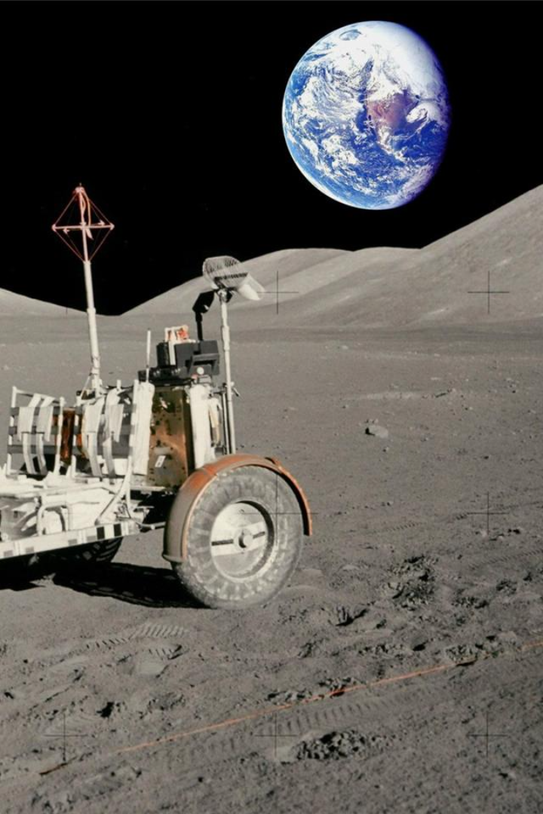
Lunar Navigation
Lunar navigation is a fascinating and complex task that requires advanced technology and precise mapping for safe and accurate landings on the moon. Let's explore the key elements involved in this exciting process!
By
Rahul Kumar Singh (UI21CS44)
Vipin Sharma (UI21CS65)

Slide 2

Hazard Maps
Mapping the Moon's Hazards
Super-Resolution Techniques
Utilizing Super-Resolution
Creating hazard maps is the first step in safely navigating a lunar lander. These detailed maps help us identify potential risks and plan our landing strategy effectively.
To overcome the challenge of working with lower resolution data, we employ super-resolution techniques. These methods enhance the quality of lunar images, making them suitable for further analysis and navigation.
The super-resolution techniques we use involve advanced deep learning models, particularly the powerful Keras framework. By leveraging generative adversarial networks (GANs), we can improve image resolution and sharpness.

Slide 3
Crater Detection
1
Identifying Lunar Hazards
2
Elliptical Object Retrieval
3
Enhancing Accuracy with OpenCV
Crater detection is essential for terrain relative navigation and hazard avoidance during lunar landings. We employ sophisticated computer vision models to identify and analyze craters in high-resolution lunar images.
Our crater detection model utilizes the Ellipse R-CNN, a powerful model that combines Mask R-CNN for elliptical object retrieval and U-Net Semantic Segmentation for learning occlusion patterns within crater images.
To ensure accurate crater identification, we leverage pre-trained computer vision models from OpenCV. These models assist us in precisely detecting and analyzing craters on the lunar surface.

Slide 4

Crater Matching
1
Identifying Crater Patterns
Once craters are detected, we focus on identifying patterns within these unique lunar features. This aids in faster and more accurate recognition of craters, enhancing the navigation process and improving hazard assessment.
2
Advanced Pattern Recognition
We employ advanced pattern recognition algorithms that analyze the shape, size, and distribution of craters on the moon's surface. This enables us to identify and match craters with precision.
3
Improving Navigation Efficiency
By identifying and matching crater patterns, we can optimize the navigation process. This allows for more efficient and safer lunar landings, reducing the risks associated with unfamiliar lunar terrains.

Slide 5
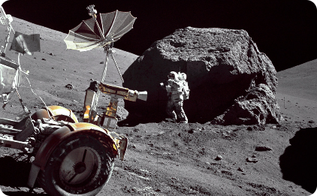
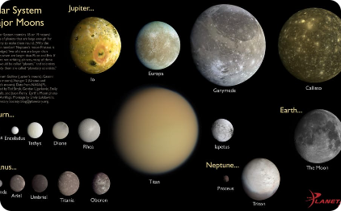
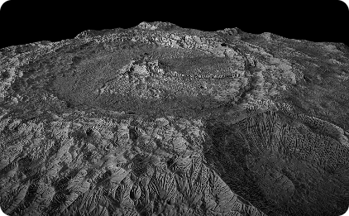
Visual Terrain Relative Navigation
Identifying Lunar Surface Features
Depth Estimation for Safety
Terrain Classification
To classify different types of lunar terrains, we utilize DenseNet, a state-of-the-art convolutional neural network architecture. This segmentation technique helps us plan routes and avoid potential obstacles.
In addition to crater detection, we identify other critical lunar surface features such as boulders, rifts, and slopes. This information helps with route planning and obstacle avoidance.
Depth estimation is crucial for visual terrain relative navigation. We employ advanced machine learning techniques, such as Pix2Pix and GANs, to determine the depth of the moon's surface relative to the camera's position, enhancing safety and precision.

Slide 6

Challenges and Dependencies
1
Fine-Tuning for Optimal Results
While our approach shows promise, feature-based transformations like super-resolution require tuning and balancing to achieve optimal results. Continual refinement and improvement are necessary to enhance the quality of lunar navigation.
2
Dealing with Lunar Lighting Conditions
Lunar lighting conditions pose challenges for image analysis. Areas of permanent shadow and intense sunlight require adaptive algorithms to ensure accurate detection of lunar features.
3
Continual Research and Updates
The dynamic lunar environment requires regular updates to our navigation system. As we learn more about the moon and its terrains, we continuously refine our methods and models to ensure the safety and success of lunar missions.

Slide 7
Cutting-Edge Technology for Lunar Navigation
Deep Learning Models (Keras)
Ellipse RCNN
Our lunar navigation system heavily relies on deep learning models to process and analyze lunar images. These models enable us to accurately detect and classify various lunar features.
Ellipse R-CNN is a specialized technology stack for object detection. It is commonly employed in applications such as crater detection. Leveraging Region-based Convolutional Neural Networks (R-CNN) principles, Ellipse R-CNN excels in accurately locating and classifying elliptical objects, making it a valuable tool for tasks requiring precise shape recognition, such as identifying craters in satellite imagery.
Fine-Tuned Generative Models (GANs)
OpenCV
OpenCV is a versatile computer vision library widely used for image and video processing. It provides a seamless interface for utilizing pre-trained models, facilitating tasks such as object detection, face recognition, and image classification.
We employ fine-tuned generative models, such as generative adversarial networks (GANs), to enhance the resolution, sharpness of lunar images and depth estimation. These models help us extract valuable information for navigation and analysis.

Slide 8
Cutting-Edge Technology for Lunar Navigation
DenseNet
Python
DenseNet, a convolutional neural network architecture, is adept at terrain classification tasks. Known for its dense connectivity pattern, where each layer receives direct input from all preceding layers, DenseNet promotes feature reuse, making it effective for capturing intricate patterns in terrain data.
It is the foundation for the given models.
Leveraging its densely connected structure, DenseNet enhances model performance in discerning diverse terrain types from satellite or aerial imagery, making it a robust choice for applications requiring accurate and detailed terrain classification.

Slide 9
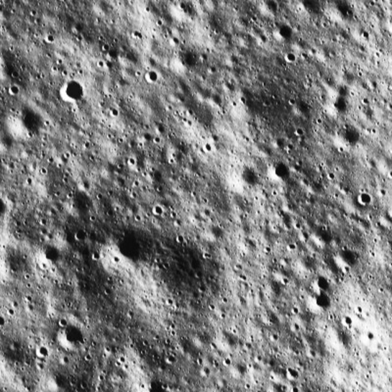
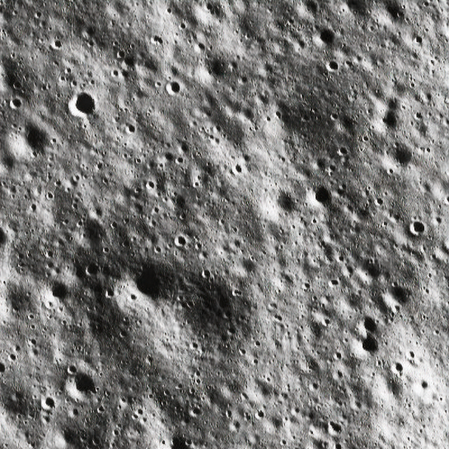
Result and analysis
Image Super Resolution
Input
Output

Slide 10
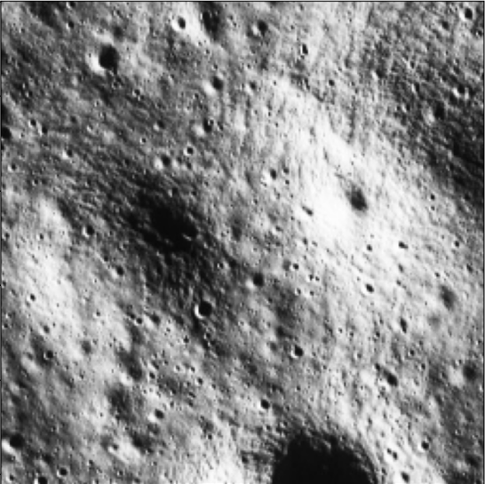
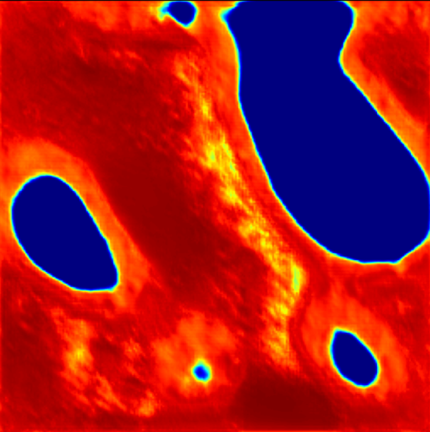
Result and analysis
Depth Resolution
Input
Output

Slide 11
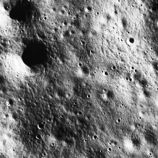
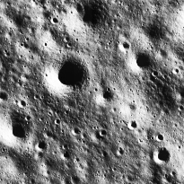
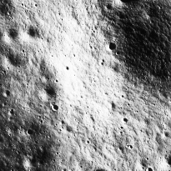
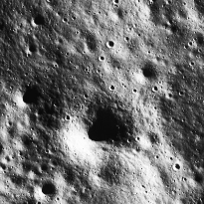
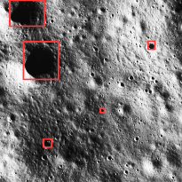
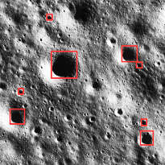
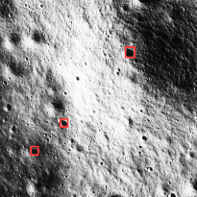
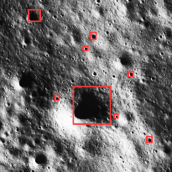
Result and analysis
Crater Detection
Input
Sample 1
Sample 2
Sample 3
Sample 4
Output
Result 1
Result 2
Result 3
Result 4

Slide 12
Overall Result after training the model with different samples

Slide 13
Overall Result after training the model with different samples

Slide 14
Advancing Lunar Exploration
1
Safe and Precise Lunar Landings
2
Facilitating Scientific Endeavors
By combining cutting-edge technology and innovative methods, our lunar navigation system ensures safe and precise landings on the moon's surface. This is crucial for future lunar exploration missions.
Accurate lunar navigation opens up opportunities for scientific research and exploration. By enabling reliable and efficient navigation, we empower scientists to conduct experiments and collect valuable data.

Slide 15
Thank You

